Slide 1


Anastasiia Filchenko
January 21, 2022

Slide 2

Outline
Executive Summary
Introduction
Methodology
Results
Conclusion
Appendix

Slide 3
Executive Summary
Summary of methodologies
Tools: Python and SQL
Data sources: API and web page
Visualizations: scatter plots, folium maps, dashboard
Supervised machine learning: classification
Summary of all results
SpaceX is quite successful in recovering the first stage of its rockets, continually improving since 2013
Payload mass, destination (orbit) and booster version to a large extent define how successful the landing outcome will be
SpaceX fails continuously to recover the first stage after launching rockets to ISS or GTO orbits; SpaceY can investigate this opportunity further

Slide 4
Introduction
Project background and context
SpaceY wants to enter the aerospace manufacturing business and looks up to a potential rival company SpaceX. What makes SpaceX attractive to the clients is the lower cost of the rockets which is achieved by reusing the most expensive part of the rocket – it’s first stage. The main task of this project is to analyze public SpaceX launch data (Falcon 9) and predict whether the first stage will be recovered (successful landing outcome) and eventually determine the price of the rocket manufacturing for SpaceY.
Questions
How successful is SpaceX in recovering the first stage of the rockets?
What drives un/successful landing outcomes?
Should SpaceY bid against SpaceX?

Slide 5


Slide 6
Methodology
Executive Summary
Data collection methodology:
SpaceX API and web scraping of Wikipedia page
Perform data wrangling
Perform exploratory data analysis (EDA) using visualization and SQL
Perform interactive visual analytics using Folium and Plotly Dash
Perform predictive analysis using classification models
Convert all categorical variables to dummy variables (0/1) and normalize
Split dataset into training and test sets (80/20)
Train classification models with selected hyperparameters and apply on test sets
Compare confusion matrices and accuracy score to define the best performing model

Slide 7
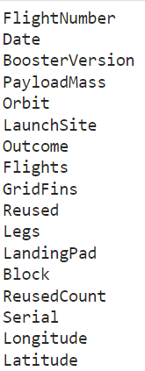
Data Collection
Data extracted:
Falcon 9 data was collected using:
SpaceX API with Requests library
https://api.spacexdata.com/v4/launches/past
Web scraping of Wikipedia page with Requests and BeautifulSoup libraries
https://en.wikipedia.org/w/index.php?title=List_of_Falcon_9_and_Falcon_Heavy_launches&oldid=1027686922

Slide 8
Data Collection – SpaceX API
Collecting data thru API:
Get data using URL and get method from Requests library
Decode response content as JSON using json method and turn it to dataframe using Pandas json_normalize method
Client: SpaceY
API request
Resource:
SpaceX
Data
API request in form of HTTP message was sent from Client (SpaceY) to Resource (Space X). Response in form of JSON file containing requested data was sent back to Client.
https://github.com/anastasiiaf/ibm_data_science/blob/master/Capstone/data-collection-api.ipynb

Slide 9
Data Collection - Scraping
Scraping HTML page:
Find table header tags ('th') and table rows ('td') using method find_all from BeautifulSoup
Iterate through elements of each row to extract and save data to dictionary
Convert dictionary to Pandas dataframe
Install and import Requests and BeautifulSoup libraries
Download webpage using URL and get method with attribute text from Requests
Create BeausifulSoup object from loaded page
Parse through HTML page
https://github.com/anastasiiaf/ibm_data_science/blob/master/Capstone/data-collection-webscraping.ipynb

Slide 10
Data Wrangling
Data types were checked, numerical and categorical variables identified
Dataset was treated for missing values
Ad hoc EA was performed on launch sites and orbit types data using pandas value_counts method
Based on categorical variable Outcome a new variable Class was introduced: 0/1 – un/successful landing of the1st stage
https://github.com/anastasiiaf/ibm_data_science/blob/master/Capstone/data-wrangling.ipynb

Slide 11
EDA with Data Visualization
To get a better insight into data, i.e. what might explain launch outcomes, the following relationships between flight number (continuous flight attempts), payload mass, launch site and orbit type were examined:
FlightNumber vs PayloadMass
FlightNumber vs LaunchSite
PayloadMass vs LaunchSite
FlightNumber vs OrbitType
PayloadMass vs OrbitType
https://github.com/anastasiiaf/ibm_data_science/blob/master/Capstone/EDA-visualization.ipynb

Slide 12
EDA with SQL
SQL queries performed:
Landing outcome: the first successful landing, landing types, list of boosters for specific outcomes, and ranking the count of outcomes for certain periods
Payload mass: total payload mass per customer
Boosters: explore boosters for heavy payload mass rockets
https://github.com/anastasiiaf/ibm_data_science/blob/master/Capstone/EDA-sql.ipynb

Slide 13
Build an Interactive Map with Folium
To get a better overview over rocket launch locations, the following objects were added to the interactive map:
Launch site areas
Launch outcomes per site
Launch site proximity to highways, railroads, towns and coast
https://github.com/anastasiiaf/ibm_data_science/blob/master/Capstone/EDA-launch-site-location.ipynb

Slide 14
Build a Dashboard with Plotly Dash
Data suggests that payload mass of the rocket and its booster version have a strong affect on landing outcome. To visualize these relationships, two charts were added to the dashboard:
Pie chart: Success rate (per site), %; and Total successful landings by site, %
Scatter plot: Launch outcomes by site within selected payload mass range, giving insight into which booster versions were used
https://github.com/anastasiiaf/ibm_data_science/blob/master/Capstone/EDA-dashboard.py

Slide 15
Predictive Analysis (Classification)
Following the process steps described on the right, four classification models were tested:
Logistic Regression
Support Vector Machine
Decision Tree
K-Nearest Neighbors
To find the best performing model, confusion matrix was plotted, and accuracy score (score method) was calculated for each model.
Import sklearn library
Standardize independent variables
Split data into training and testing sets using train_test_split function
Train models using training dataset and find hyperparameters with GridSearchCV
Test models using test data and find best performing model (highest accuracy score) score function
https://github.com/anastasiiaf/ibm_data_science/blob/master/Capstone/ML-prediction.ipynb

Slide 16
Results
Exploratory data analysis results for Falcon 9
The average success rate of retrieving the first stage is around 67% and around 80% in 2020
Depending on destination (orbit) and payload mass, the launch outcomes variate:
Very successful with launching heavy payload mass rockets
Very successful with launching to orbits VLEO, LEO and PO
Numerous but least successful with launching to orbits ISS and GTO
In majority of successful landings booster versions FT and B4 are used
Predictive analysis results
Due to small data sample, all four classification models tested yield appx the same results, meaning every model can be used for predicting the launch outcome, and eventually price of the rocket manufacturing.

Slide 17


Slide 18
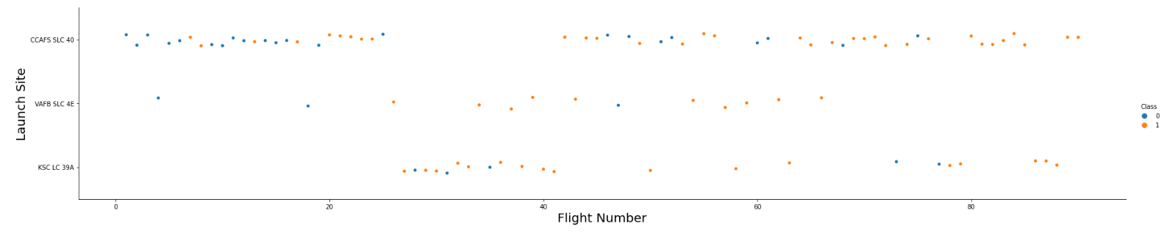
Flight Number vs. Launch Site
Majority launches took place at CCAFS SLC 40, although success rates are higher at two other sites
More launches (continuous launch attempts) increase the likelihood of getting successful landing

Slide 19
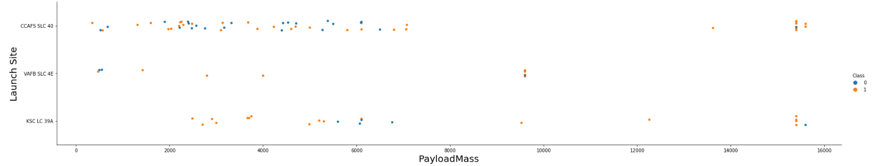
Payload vs. Launch Site
Majority of launched rockets have payload mass between 500 kg to 7000 kg
VAFB SLC 4E site has no rockets with heavy payload mass

Slide 20
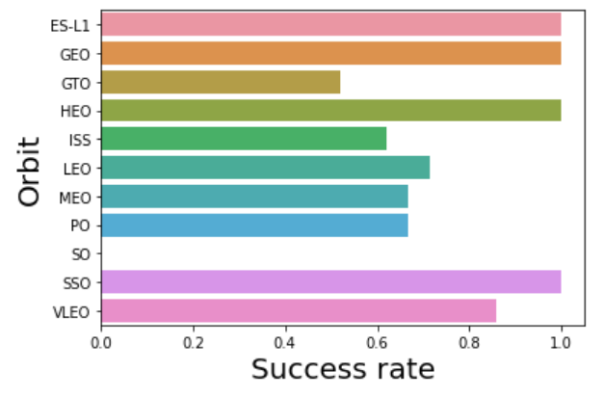
Success Rate vs. Orbit Type
Launches to orbits GTO, ISS, MEO and PO were least successful
Majority of launches happened to orbits GTO, ISS, VLEO, PO and LEO
There are few (1 to 3) launches to orbits ES-L1, GEO and HEO

Slide 21
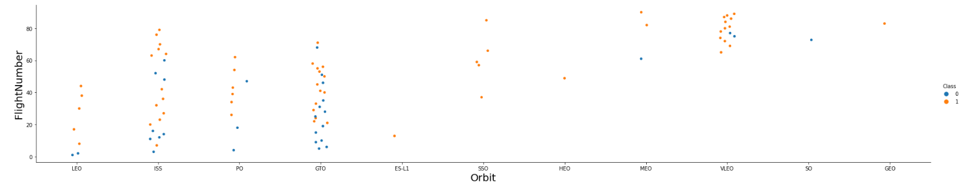
Flight Number vs. Orbit Type
Successful outcome in LEO orbit is related to the number of flights (improvement with every next launch), which is not the case for orbits ISS and GTO

Slide 22
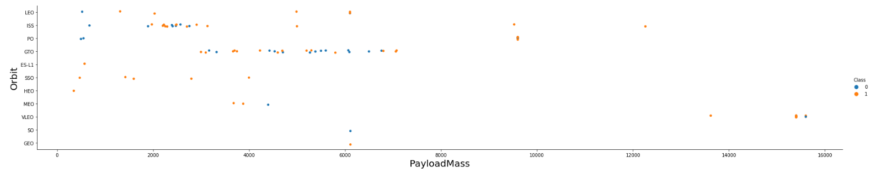
Payload vs. Orbit Type
Heavy payload mass rockets have successful outcome in orbits ISS, PO and VLEO

Slide 23
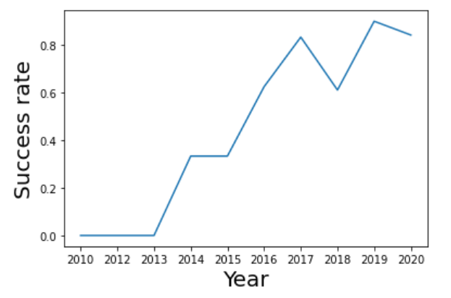
Launch Success Yearly Trend
From 2013 until 2020 success rate is increasing

Slide 24
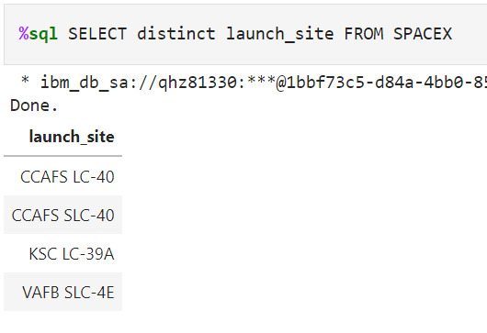
All Launch Site Names
Query result shows the names of 4 unique launch sites
SQL: keyword DISTINCT is used in SELECT statement

Slide 25
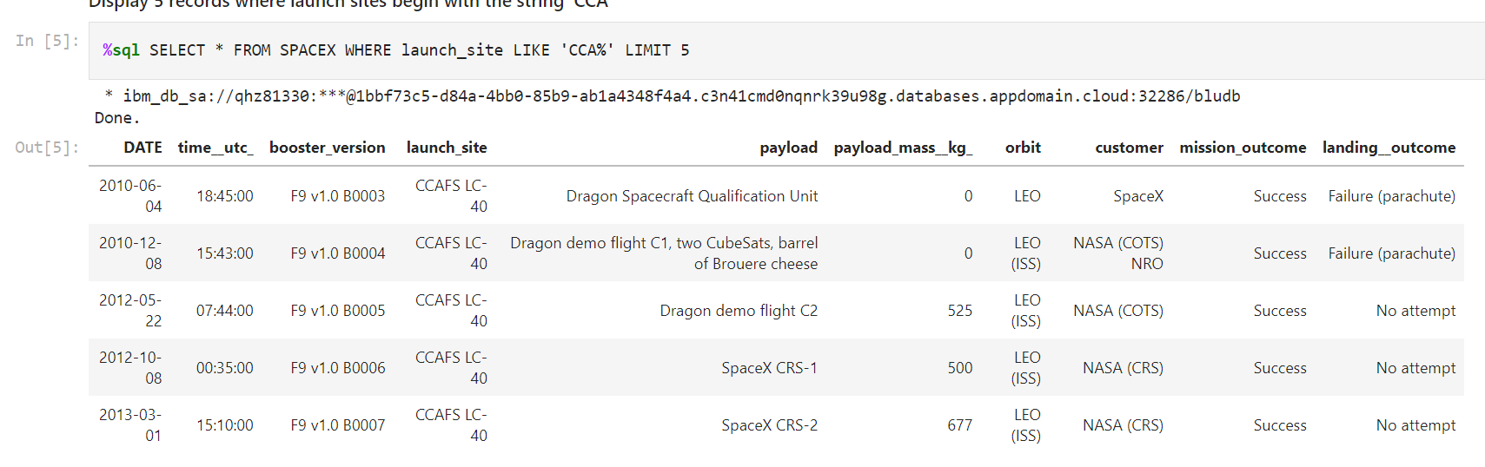
Launch Site Names Begin with 'CCA'
Query result shows 5 records where launch sites begin with `CCA`
SQL:
keyword LIKE is used to retrieve entries which contain ‘CCA’ in launch_site column
Keyword LIMIT 5 restricts the retrieved dataset to 5 entries

Slide 26
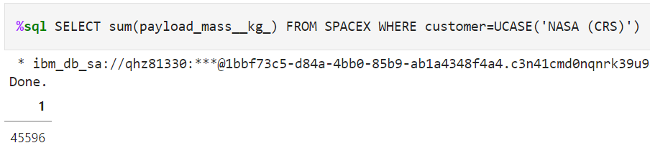
Total Payload Mass
Query result shows the total payload carried by boosters from NASA
SQL: function SUM is used to get the total sum

Slide 27
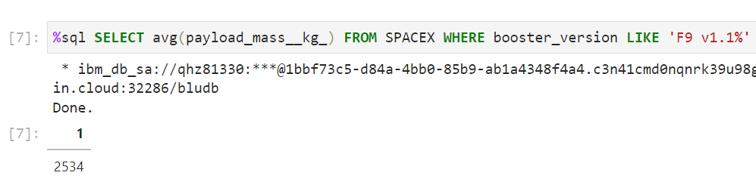
Average Payload Mass by F9 v1.1
Query result shows the average payload mass carried by booster version F9 v1.1
SQL: function AVG is used to get an average value

Slide 28
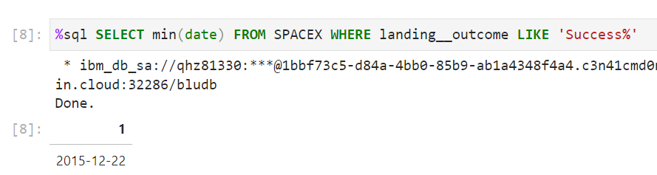
First Successful Ground Landing Date
Query result shows the dates of the first successful landing outcome on ground pad
SQL: function MIN is used to get a minimum value in a column; can be applied to date type as well

Slide 29
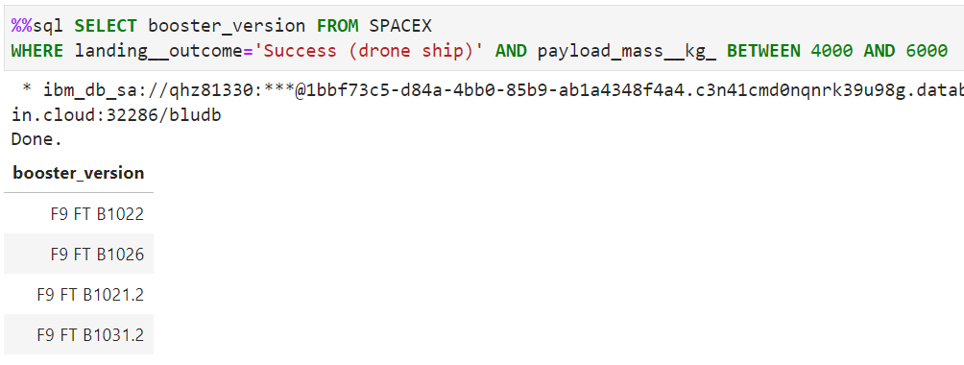
Successful Drone Ship Landing with Payload between 4000 and 6000
Query result shows the names of boosters which have successfully landed on drone ship and had payload mass greater than 4000 but less than 6000
SQL: keywords BETWEEN and AND are used to retrieve data based on several conditions in one statement

Slide 30
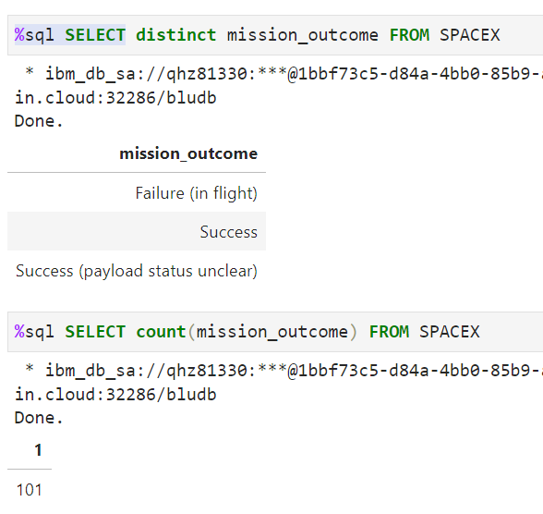
Total Number of Successful and Failure Mission Outcomes
Query result shows the total number of successful and failed mission outcomes
SQL: function COUNT is used to calculate the number of mission outcomes

Slide 31
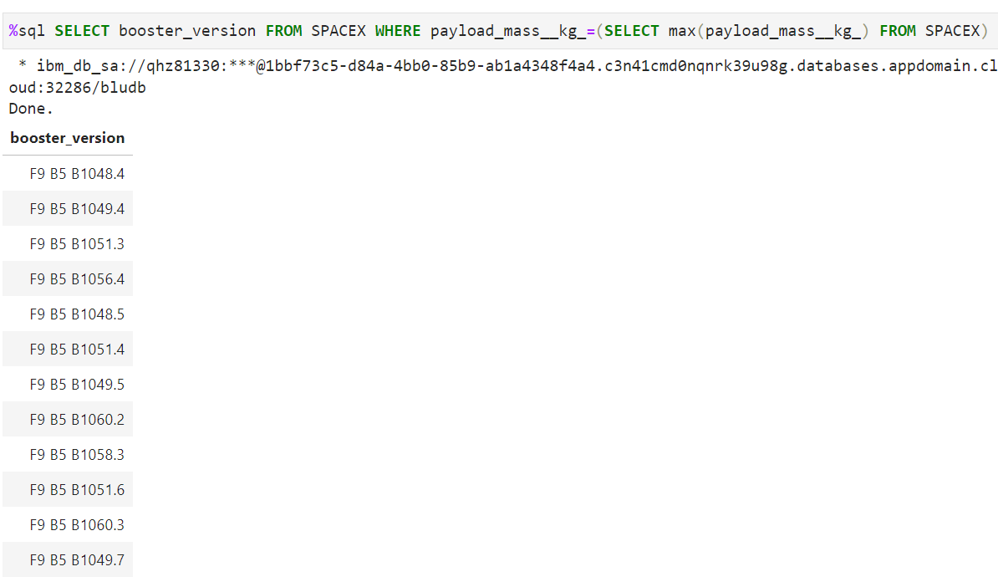
Boosters Carried Maximum Payload
Query result shows the names of the boosters which have carried the maximum payload mass
SQL: nested SELECT statement in WHERE clause

Slide 32
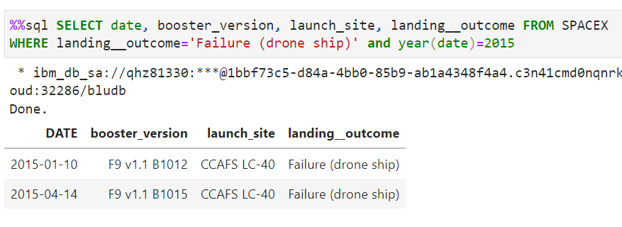
2015 Launch Records
Query result shows the failed landing outcomes in drone ship, their booster versions, and launch site names for in year 2015
SQL: function YEAR is used to retrieve year from the date

Slide 33
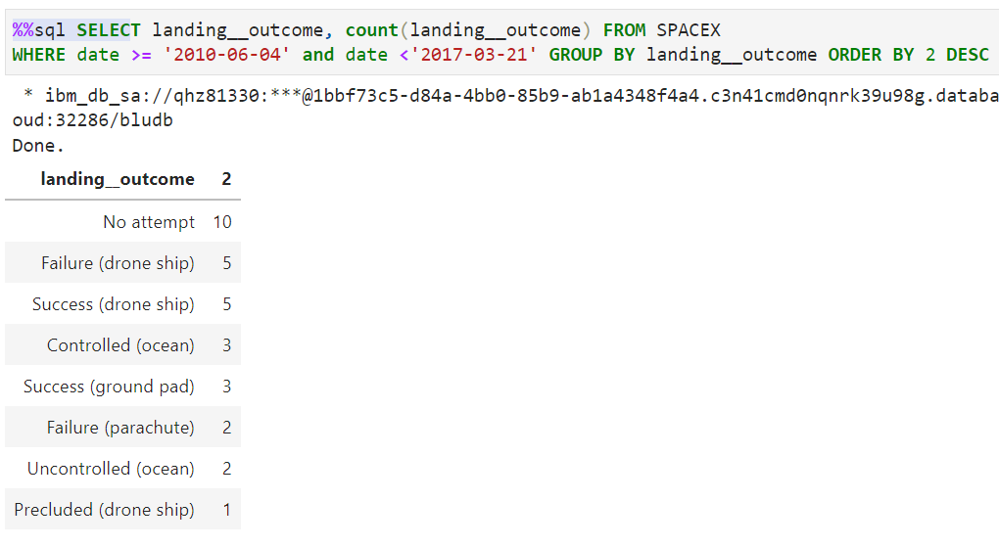
Rank Landing Outcomes Between 2010-06-04 and 2017-03-20
Query result shows the ranked landing outcomes (such as Failure (drone ship) or Success (ground pad)) between the date 2010-06-04 and 2017-03-20, in descending order
SQL: ranking is done with GROUP BY and ORDER BY clauses

Slide 34


Slide 35
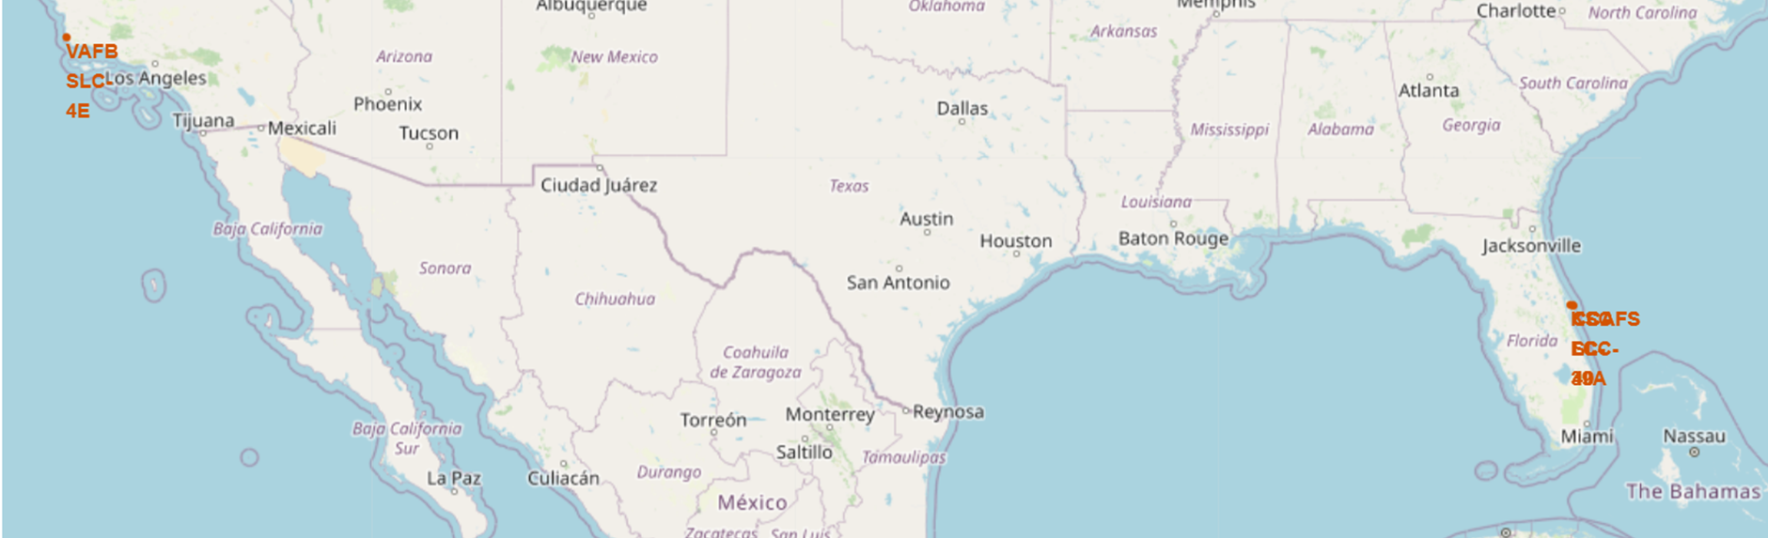
Launch sites
Launching sites are located very close to the coastal area: VAFB SLC-4E site on west coast (California, Pacific ocean) and others on east coast (Florida, Atlantic ocean)
Sites CCAFS S/LC-40 and KSC LC-39A are closer to the equator

Slide 36
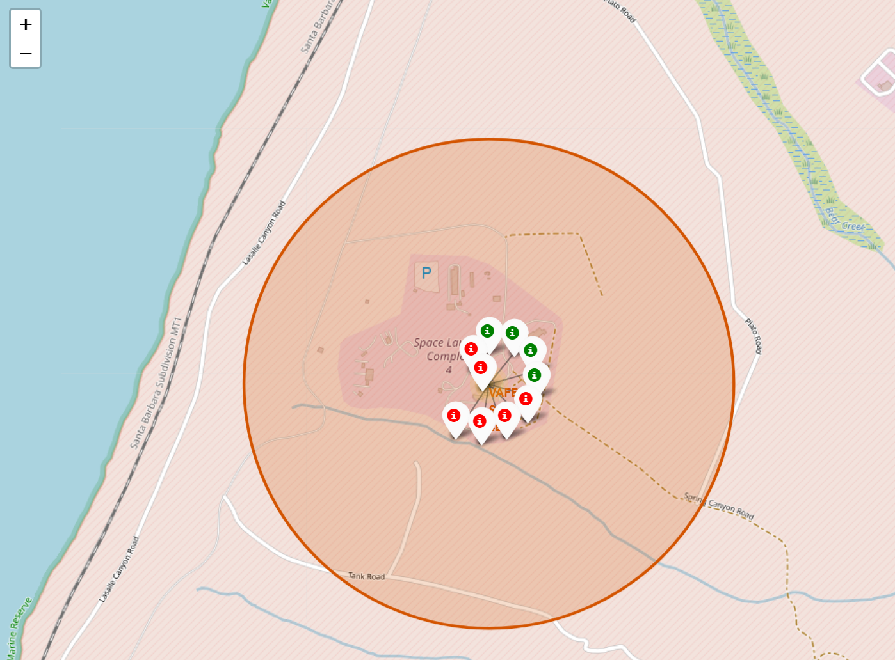
VAFB SLC-4E: launch outcomes
Out of 10 launches only 4 were successful

Slide 37
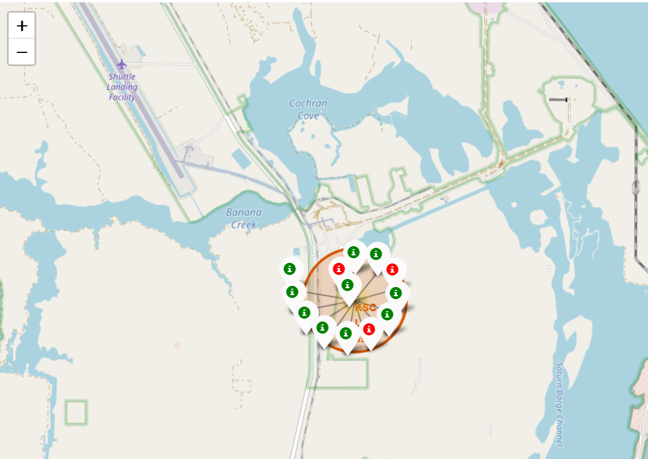
KSC LC – 39A: launch outcomes
Out of 13 launces 10 were successful

Slide 38
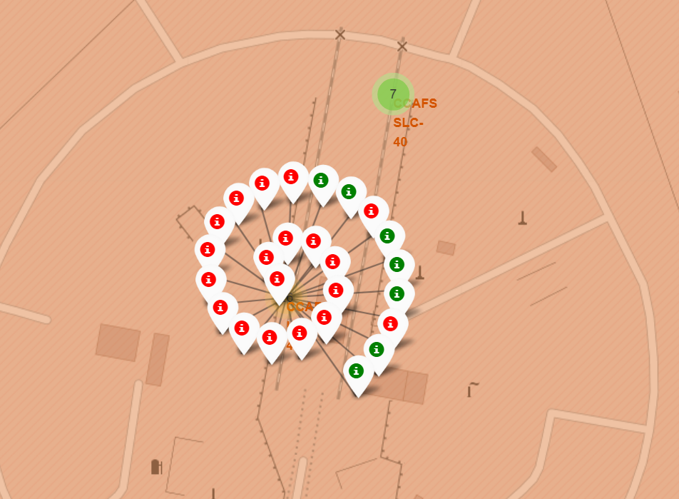
CCAFS LC-40: launch outcomes
Out of 26 launches only 7 were successful

Slide 39
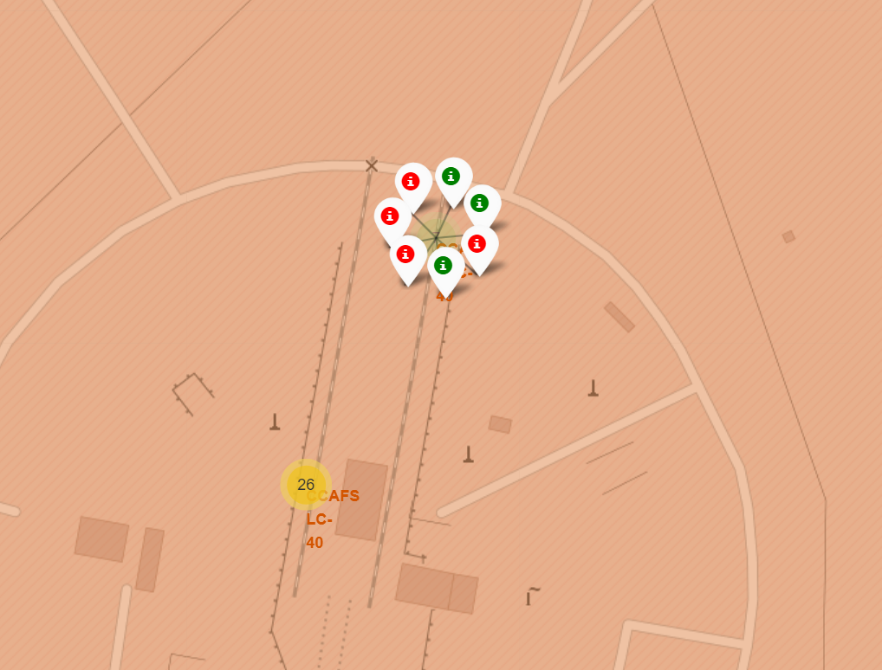
CCAFS SLC-40: launch outcomes
Out of 7 launches only 3 were successful

Slide 40
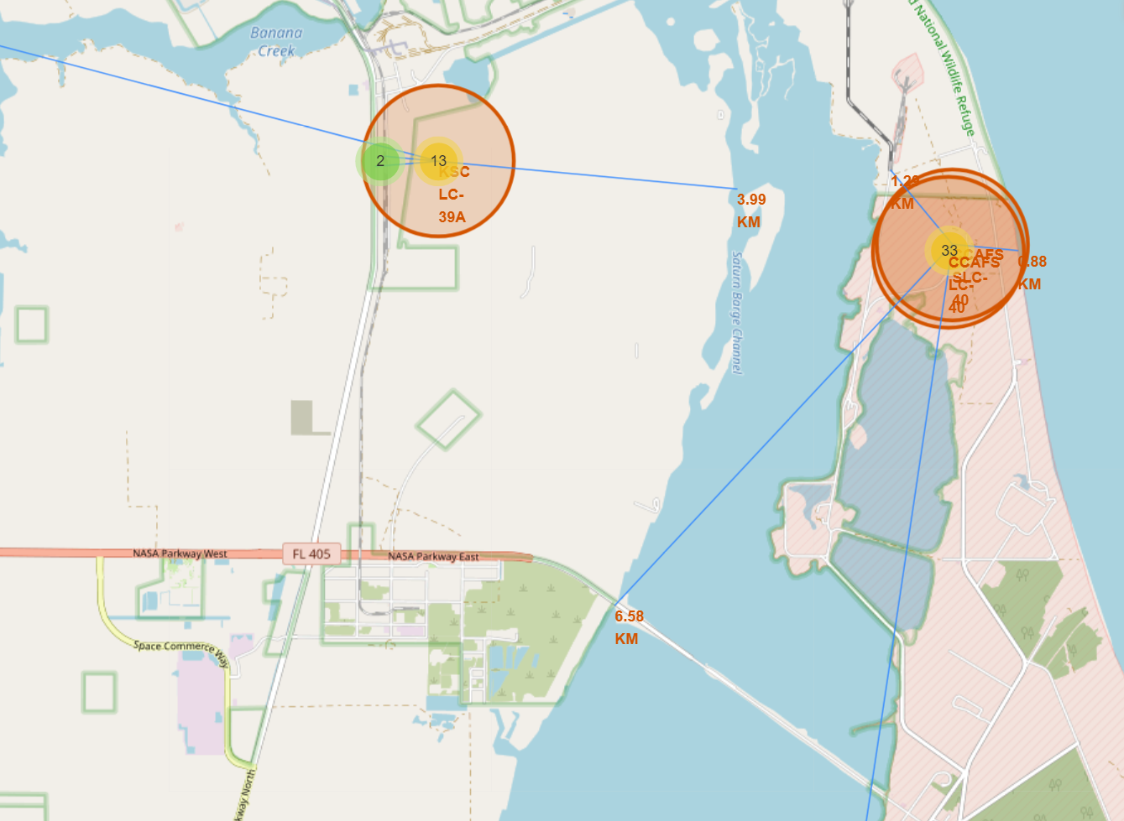
Launch sites proximity: East coast
Sites are located closer to railroads and further away from towns
Object / Site | CCAFS S/LC 40, km | KSC LC-39A, km
Coast | 0.88 | 3.99
Railroad | 1.29 | 0.72
Highway | 6.58 | 0.83
Town | 18.16 | 16.37

Slide 41
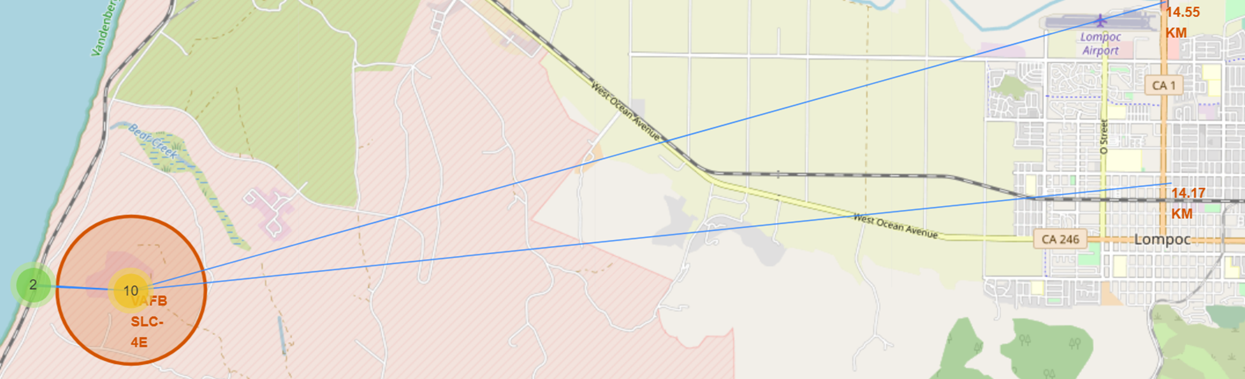
Launch sites proximity: West coast
West coast site is located nearby coast and railroad, and equally away from the closest highway and town
Object / Site | VAFB SLC-4E, km
Coast | 1.38
Railroad | 1.27
Highway | 14.55
Town | 14.17

Slide 42


Slide 43
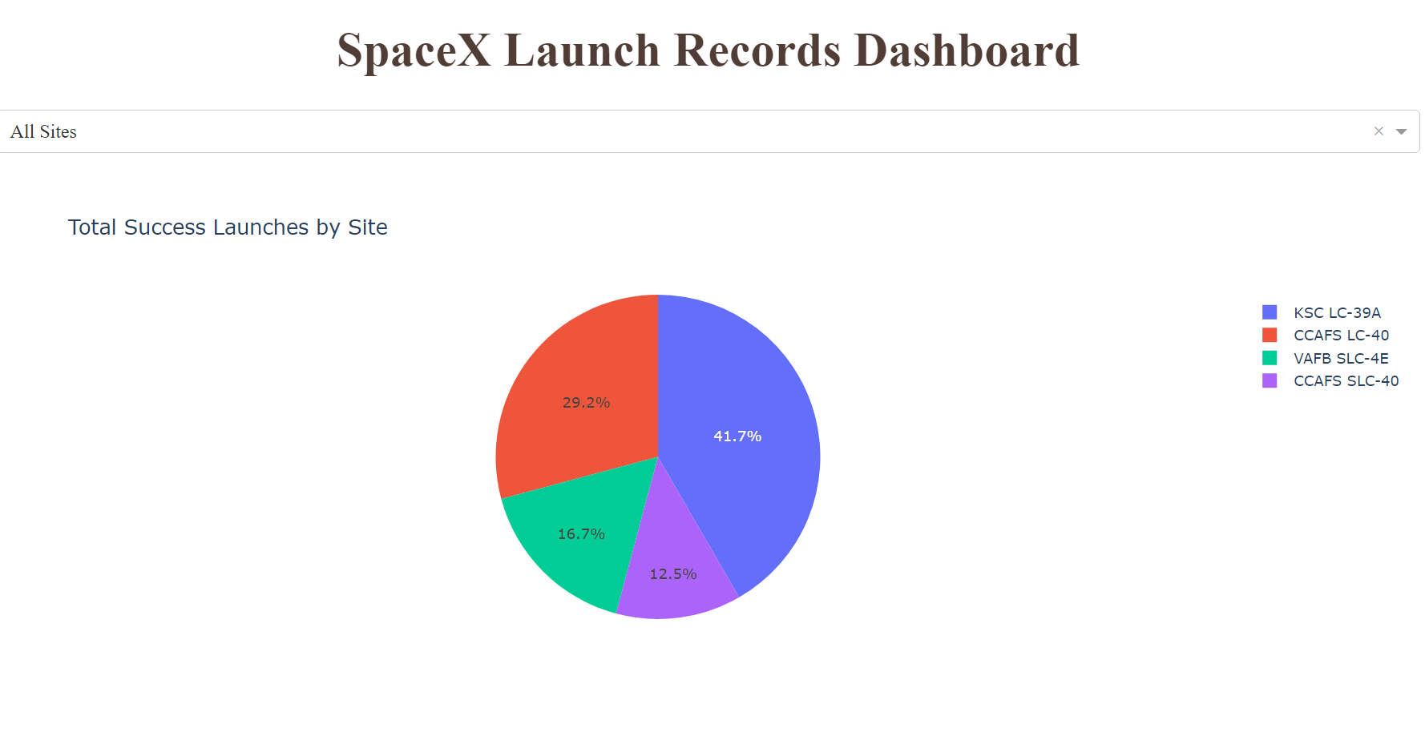
Launch sites: Success share
According to the data, around 42% of all successful rocket launch outcomes happened on site KSC LC-39A located in Florida

Slide 44
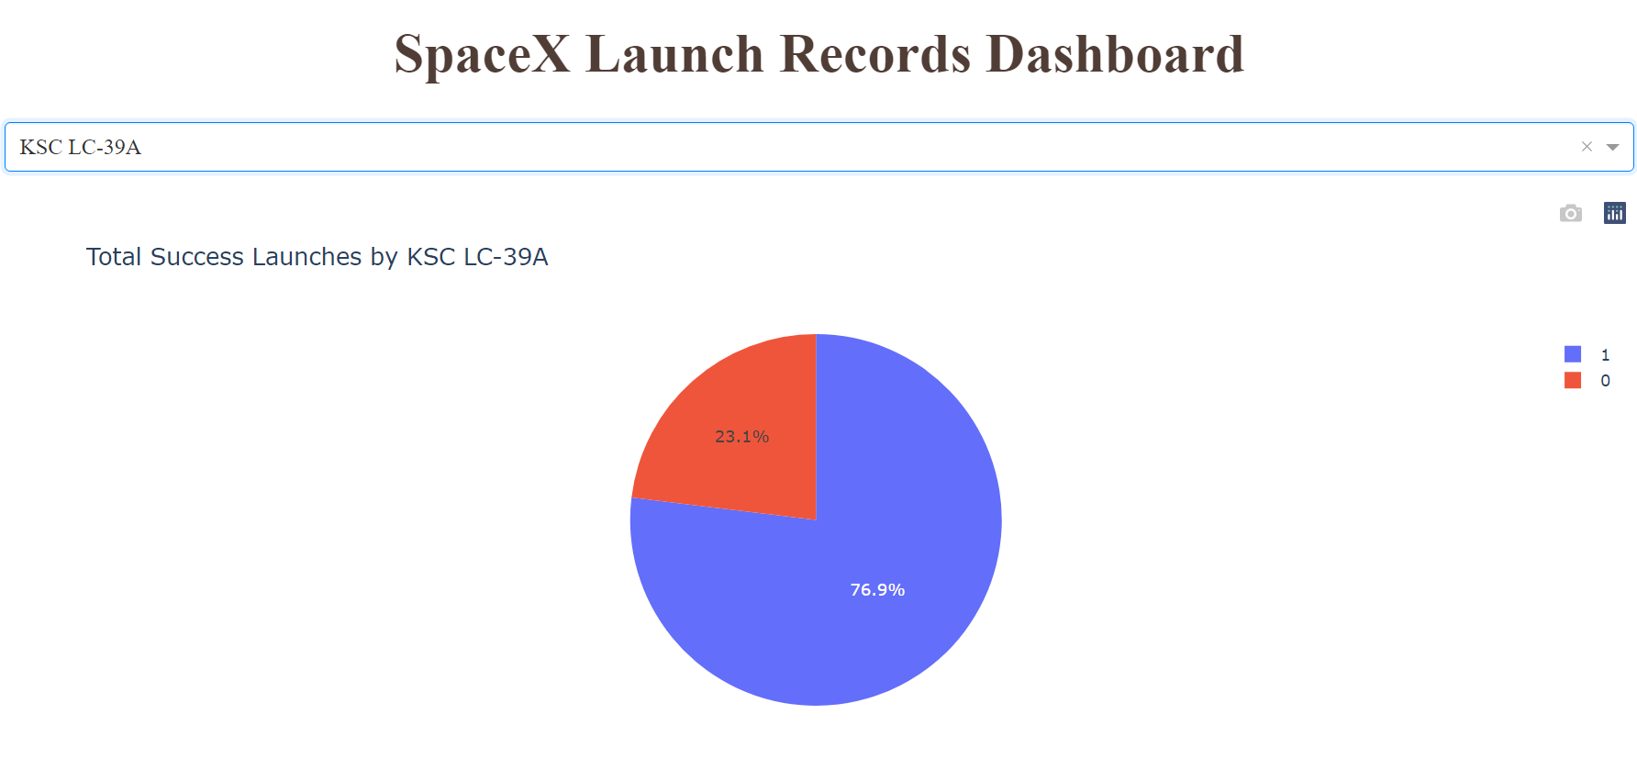
Highest launch success ratio
Among 13 launches 10 were marked as successful, yielding success ratio of 77%

Slide 45
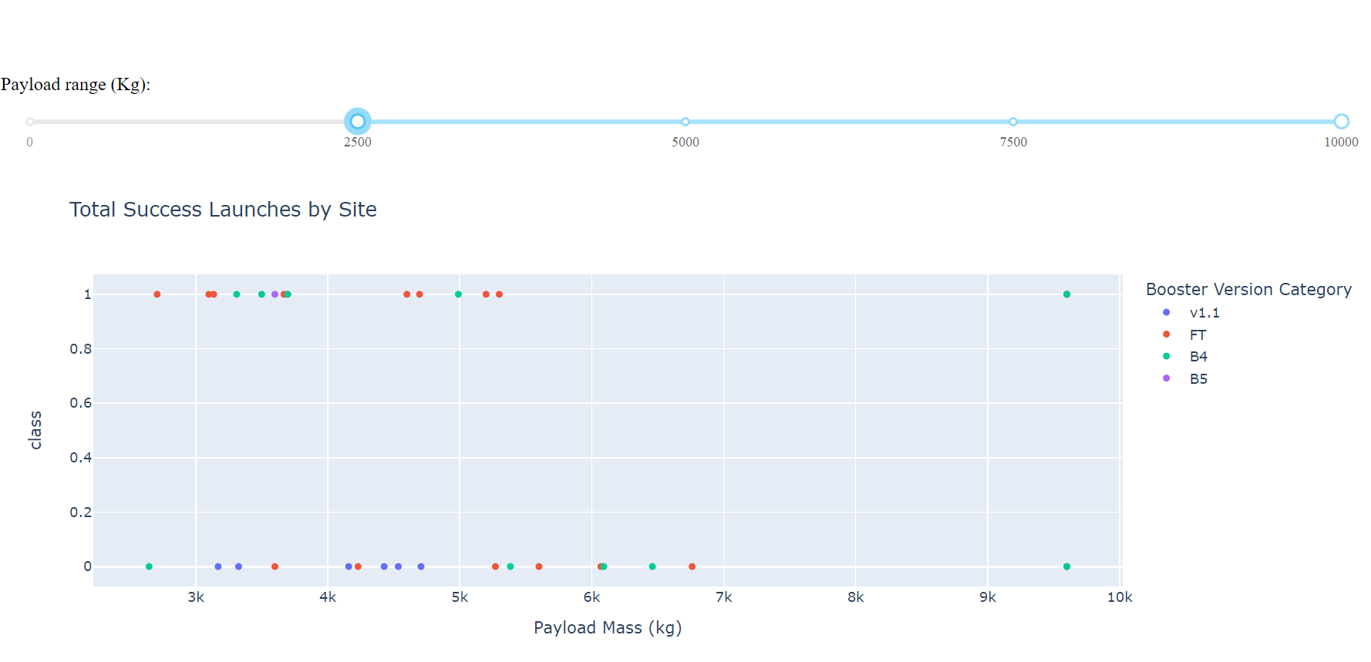
Payload mass and booster
Majority of successful launch outcomes occurred where:
Payload mass was in range from 2500 kg to 5300 kg
Booster version used was FT, followed by B4

Slide 46


Slide 47
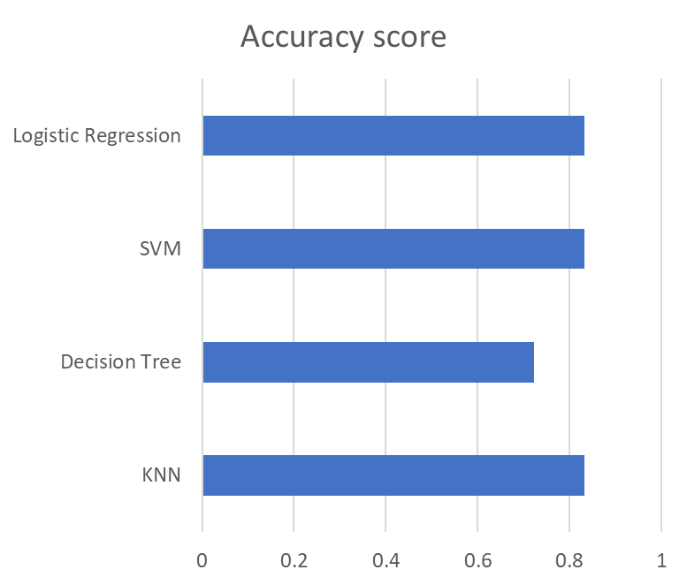
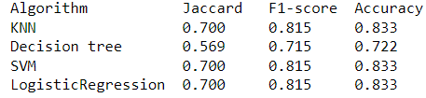
Classification Accuracy
All classification models yielded approximately the same accuracy score on test dataset, meaning that all models perform relatively well.

Slide 48
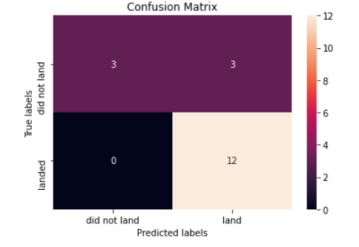
Confusion Matrix
All classification models had the same results when confusion matrices were plotted:
models were able to distinguish different classes (land / did not land)
3 landing outcomes were not classified properly (false positives)

Slide 49
Conclusions
With a collected data consisting of 90 launch entries, all tested classification models perform well and can be used to predict landing outcome and eventually price of the rocket manufacturing
To improve further model performance, collect more data on Falcon 9

Slide 50


